Slide 1




Slide 2


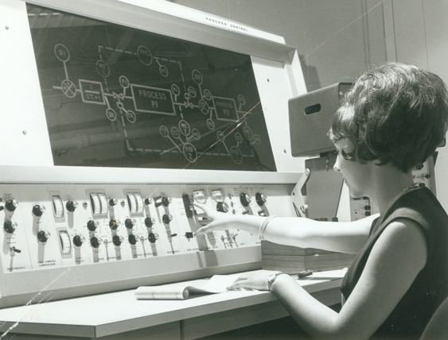
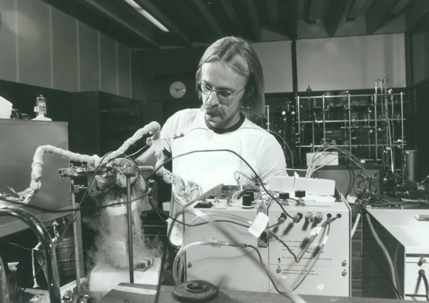
Founded July 1st, 1965

Slide 3

~9000 students
~1000 International students representing 63 countries
~86 programs - Undergrad & Grad

Slide 4
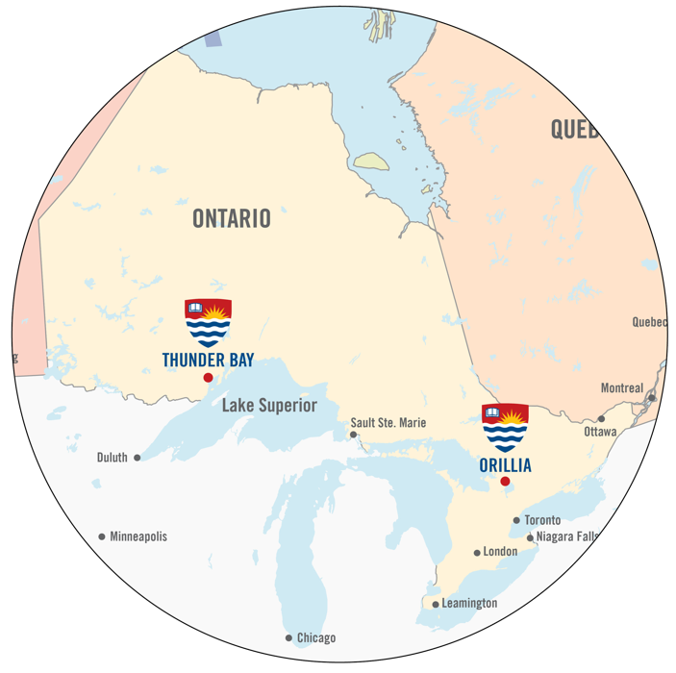
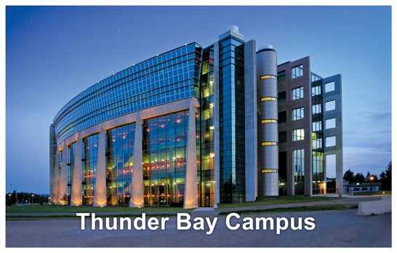


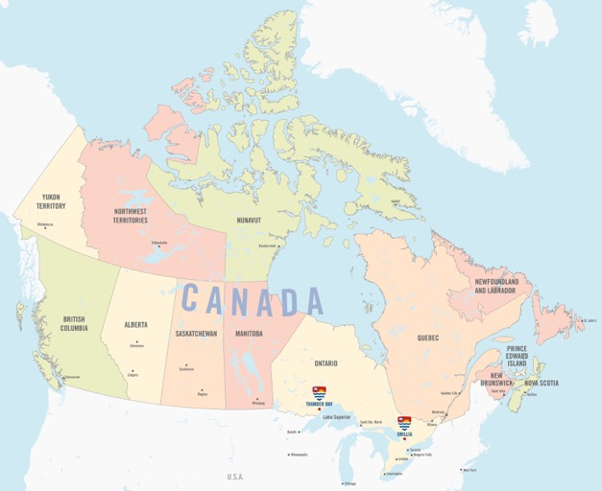
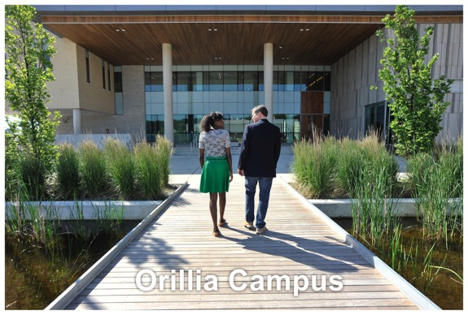
Notes:
Thunder Bay is on the world’s largest freshwater lake and offers unparalleled opportunities for outdoor recreation. 1.5 hour flight from Toronto (3 major airlines serve Thunder Bay). 60km from US border, 550km to Minneapolis.
Orillia is in Toronto’s get-away destination (cottage country). 145km to Toronto.
Thunder Bay to Duluth – 300km
Thunder Bay to Minneapolis – 560 km
Orillia to Toronto – 145 km

Slide 5
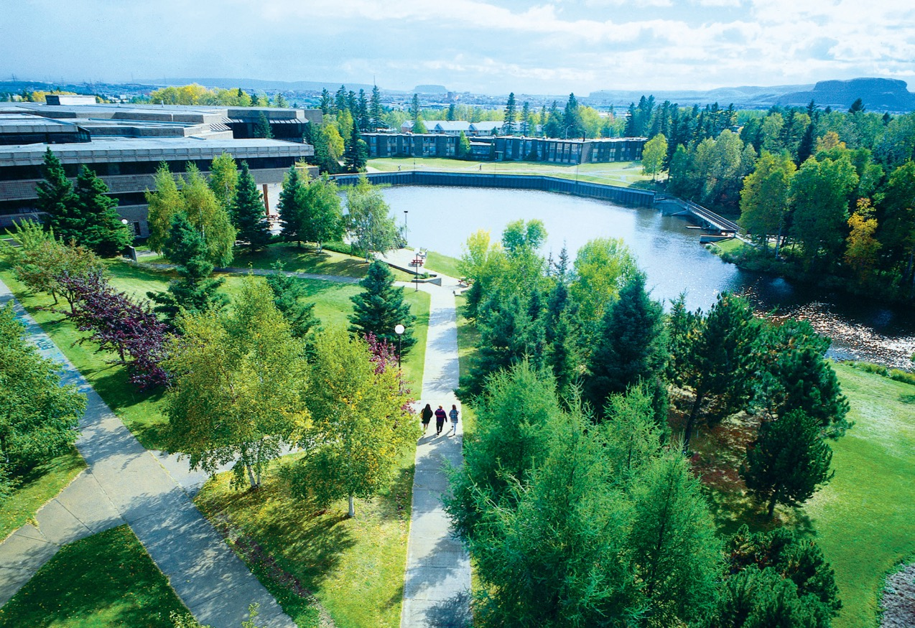
Thunder Bay Campus
~ 7700 students
Notes:
The Thunder Bay campus is in the centre of Thunder Bay on about 115 hectares of land.
A river and a small man-made lake are a centre-piece on campus

Slide 6
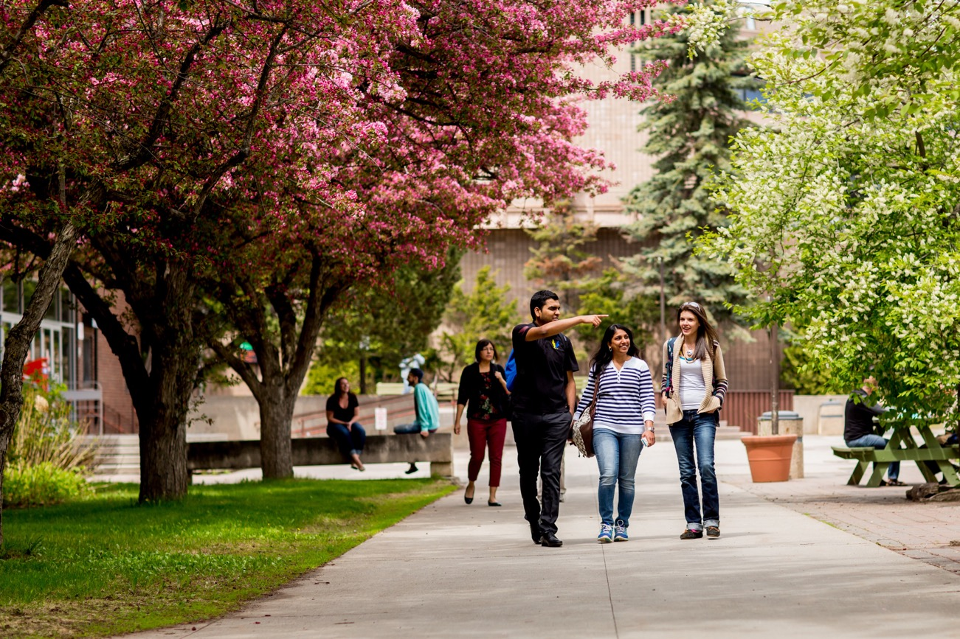
Thunder Bay Campus
Notes:
Decompress between classes in the bike/walking paths in and around campus
The natural surroundings also offer many of our natural science, geology, geography and outdoor rec classes outdoor laboratory opportunities.

Slide 7
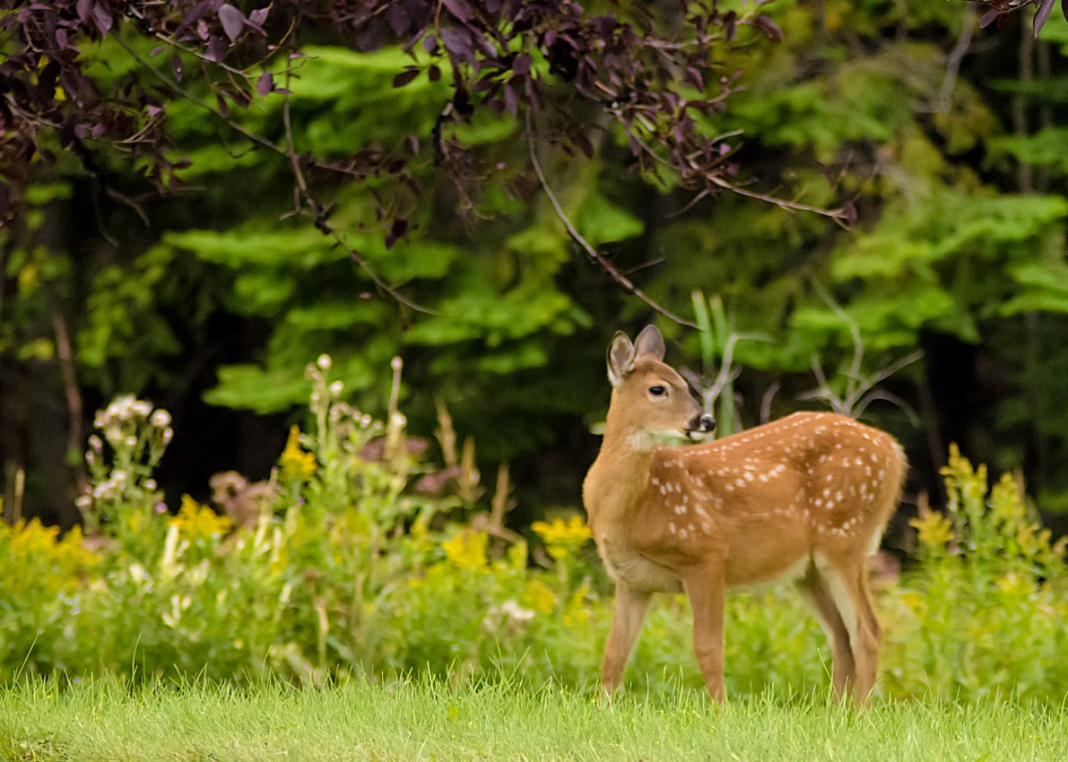
Thunder Bay Campus

Slide 8
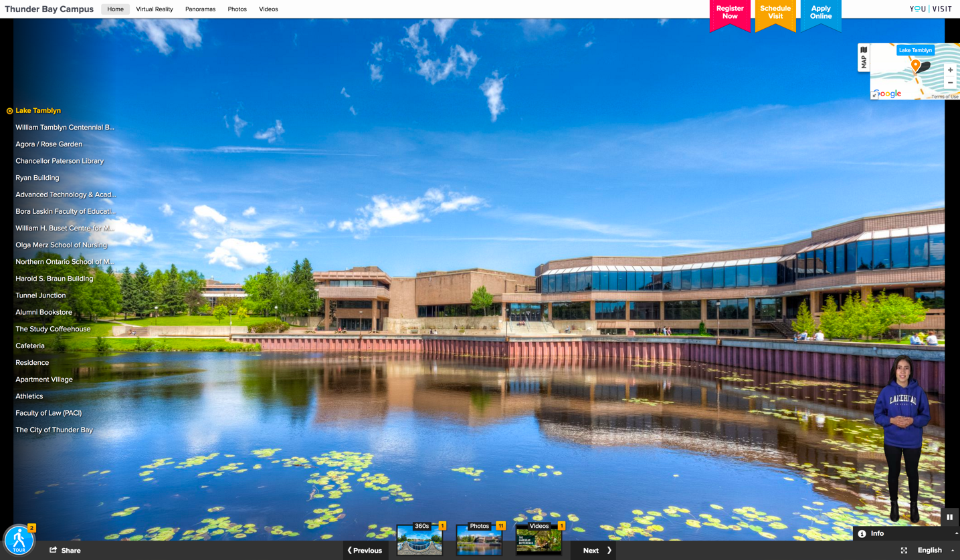
Virtual Tour of Our Campuses
youvisit.com/tour/lakeheadu

Slide 9
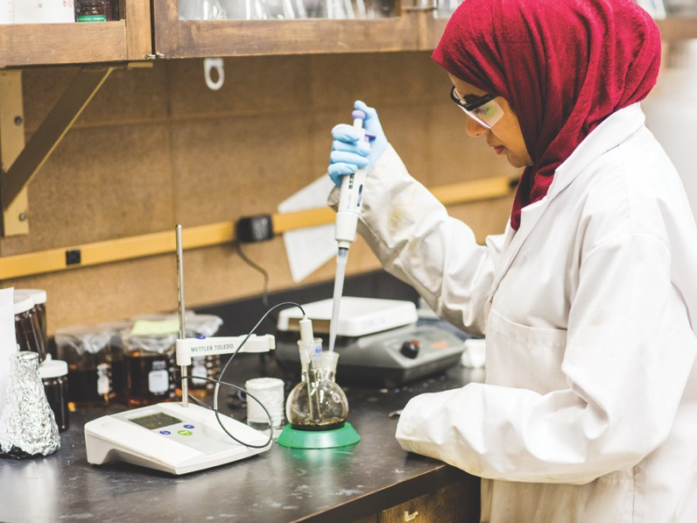
The Lakehead Advantage
Canada’s Top 3 “Best Kept Secrets” (Huffington Post)
Maclean’s 2018 Rankings:
Top 10 of Canada’s Primarily Undergraduate Universities
First Place Ranking in:
  Total Research Dollars
Re$earch Infosource 2015,2016:
#1 Undergraduate Research University in Canada
Notes:
You may have heard of some of the big universities in Canada’s largest urban centres, but Lakehead University was named one of the top three “under the radar” universities in Canada (Huffington Post).
Our students get a value-added education in which they are given the chance to play a bigger role in their classes and learning environments.

Slide 10
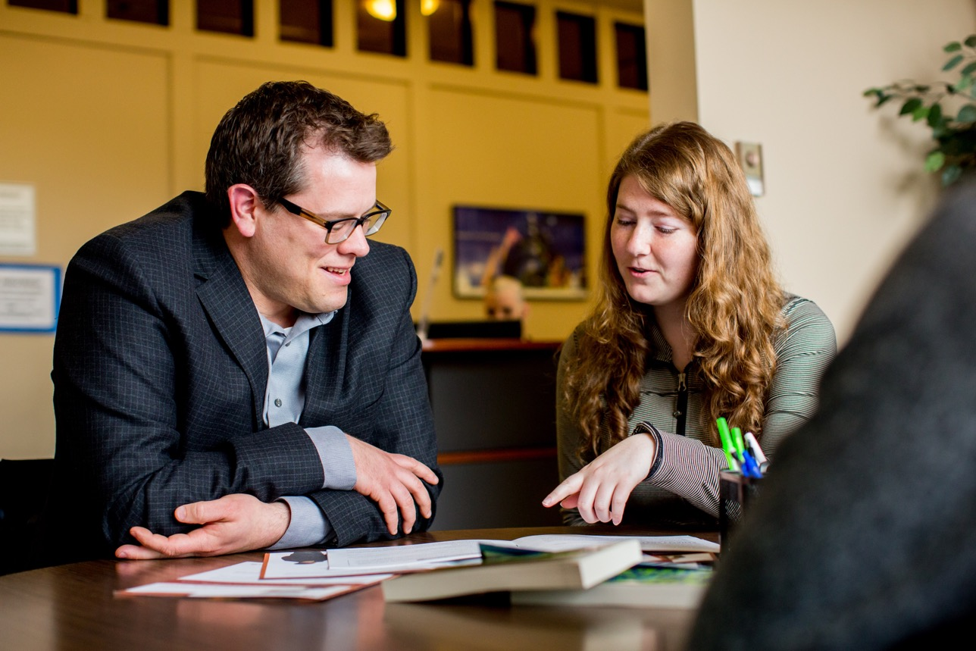
The Lakehead Advantage
Excellent Student Support
Advising, tutoring, health & counselling, student accessibility services
Writing, math, study skills and career workshops
Security services
Bookstore
Lakehead University Student Union

Slide 11

The Lakehead Advantage
Small Class Sizes
15:1 Student to Professor Ratio (Thunder Bay Campus)
13:1 Student to Professor Ratio (Orillia Campus)
Notes:
Smaller class sizes means you won’t disappear into the crowd.
You will have the opportunity for a more engaged learning experience, in which you get to know your classmates and professors.

Slide 12
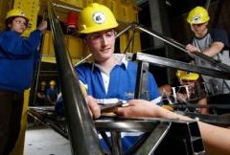
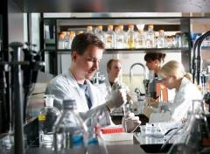
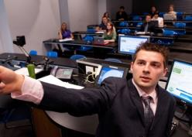
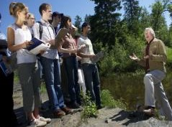
Our Academic Faculties
Social Sciences & Humanities
Science & Environmental Studies
Business Administration
Engineering
Natural Resources Management
Education
Health & Behavioral Sciences
Northern Ontario School of Medicine
Graduate Studies
Law

Slide 13

Undergraduate Programs
Aboriginal Education
Anthropology
Applied Life Sciences
Biology
Bioinformatics
Business*
Chemistry
Computer Science*
Criminology
Economics
Education - Concurrent
Education - Consecutive
Engineering – Chemical*
Engineering – Civil*
Engineering – Electrical*
Engineering – Mechanical*
Engineering – Software*
English
Environmental Management
Environmental Sciences
Environmental Studies
Environmental Sustainability
Forestry
Geoarchaeology
Geography
Geology
Gerontology
History
Indigenous Learning
Interdisciplinary Studies
Kinesiology
Languages
Law
Mathematics
Media Studies
Medicine
Music
Natural Science
Northern Studies
Nursing
Outdoor Recreation, Parks and Tourism
Philosophy
Physics*
Psychology
Resource and Environmental Economics
Social Work
Sociology
Visual Arts
Water Resource Science
Women’s Studies

Slide 14

Graduate Programs
Masters
Biology
Business Administration; Business Management
Chemistry
Computer Science
Economics
Education
Engineering: Electrical & Computer; Environmental; Civil; Mechanical
English
Environmental Studies: Northern Environments & Cultures
Forestry
Geology
Health Sciences
History
Kinesiology
Mathematical Sciences
Physics
Psychology: Clinical
Psychology: Psychological Science
Public Health
Social Justice
Social Work
Sociology
Doctoral
Biotechnology
Chemistry and Materials Science
Educational Studies
Engineering: Electrical and Computer
Engineering: Chemical
Engineering: Civil
Engineering: Software
Engineering: Mechanical
Forest Sciences
Psychology: Clinical
Psychology: Psychological Science

Slide 15
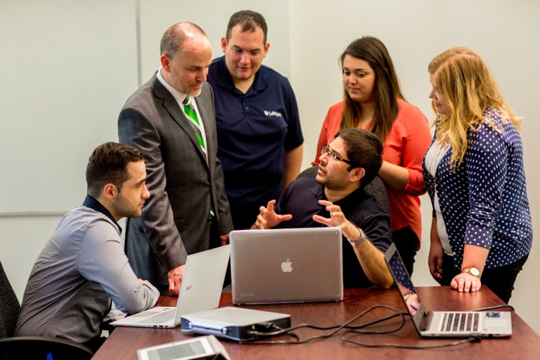
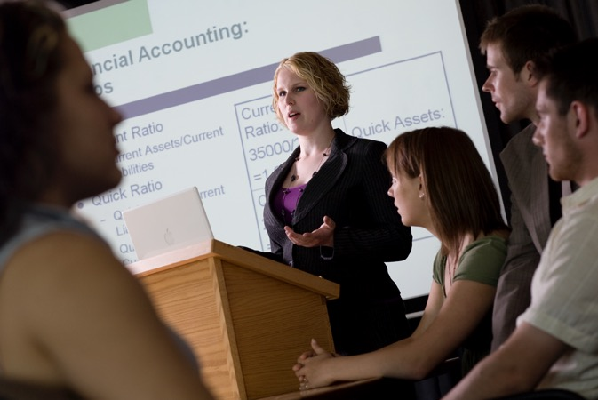
Program Highlights
Business
AACSB accredited Association of Advanced Collegiate Schools of Business, the highest standard of achievement for business schools worldwide. Less than 5% of the world's 13,000 business programs have earned AACSB Accreditation.
Business Administration (3-year)
Honours Bachelor of Commerce (4-year) Accounting, Economics, Finance, Human Resources/Industrial Relations, General Management, Information Systems & Operations, International Business, Marketing, Business Administration (Orillia), Global Entrepreneurship (Orillia)
Join the Lakehead University Business Association (LUBA)

Slide 16
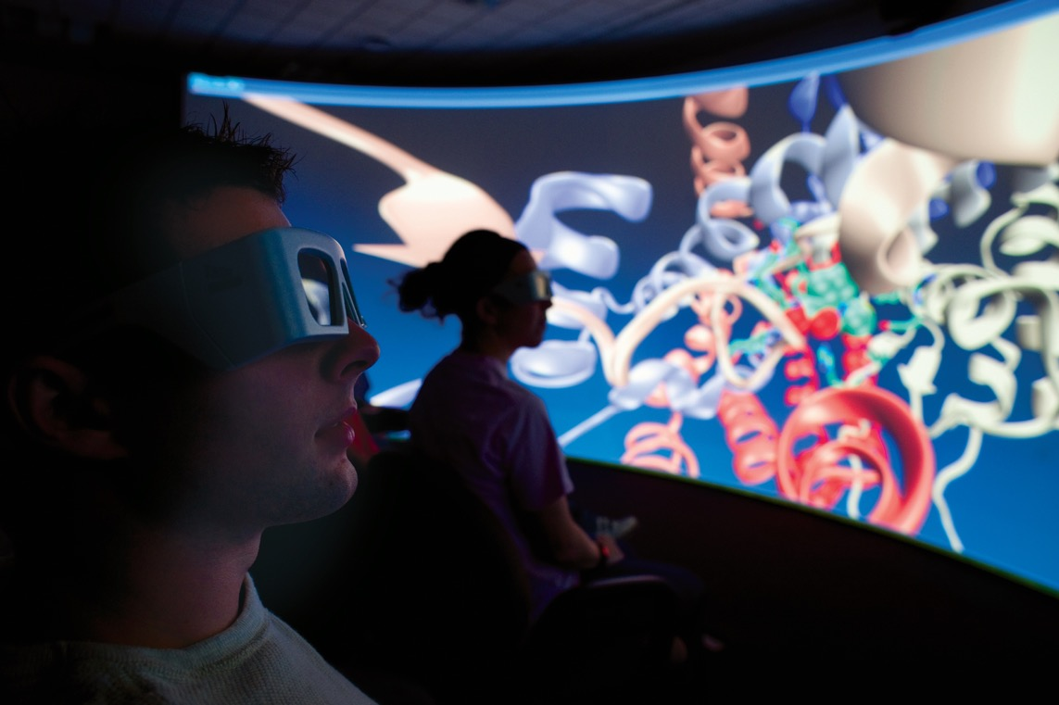
Program Highlights
Computer Science
Business or Scientific Streams
Sample core areas of study include:
Computer Programming
Data Structures
Computer Graphics
Health Informatics
Big Data
Mobile Computing
Internet Security
Artificial Intelligence
Cloud Computing
Game Programming Specialization
Comprehensive curriculum detailing several languages, including Java and C/C++
Notes:
The Computer Science department has access to some of the latest technology available in Canada:
ATAC laboratories
3-D virtual reality room
server room with cluster for parallel computing

Slide 17
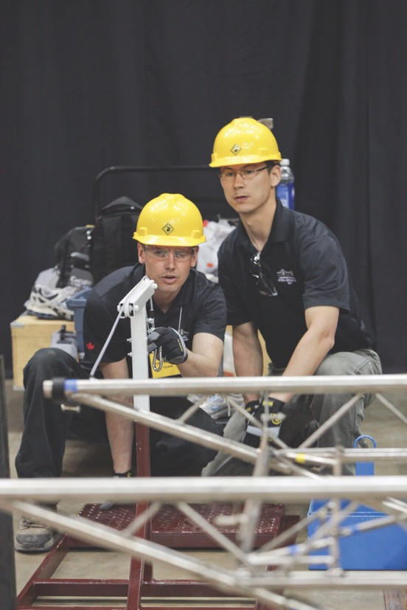
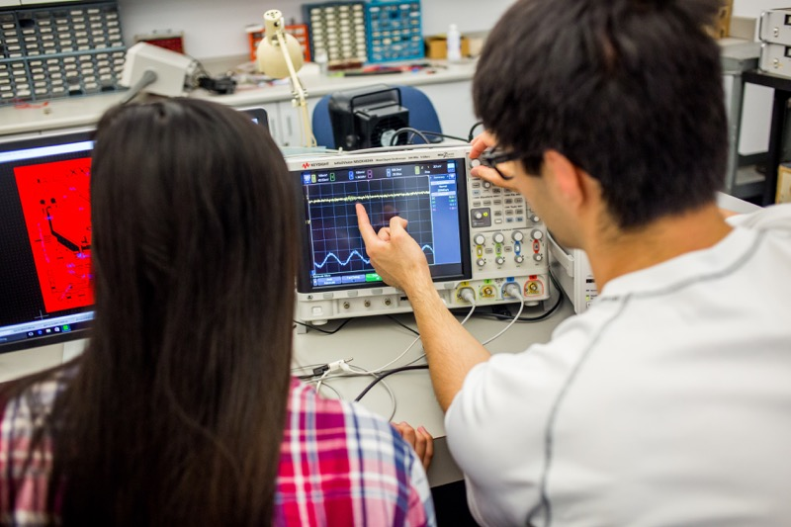
Program Highlights
Engineering
Chemical, Civil, Mechanical, Electrical, Software
Join the Lakehead University Engineering Student Society (ESS)

Slide 18
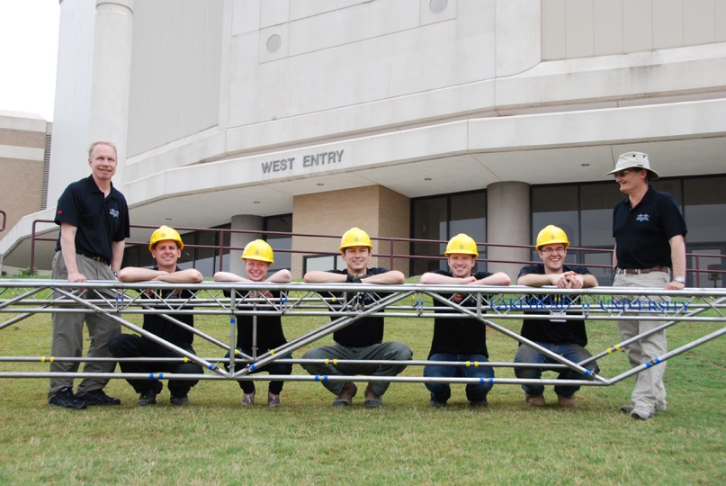
Program Highlights
Engineering Student Competitions
Civil Engineering Steel Bridge Team – only Canadian team that consistently ranks in the top 5 of the AISC/ASCE U.S. National Steel Bridge Competition
Formula SAE Team – ranked 5th and 6th respectively in 2010 and 2012 of all Canadian teams
Mechanical Engineering students designed a human powered vehicle – ranked 1st among Canadian universities and 5th overall at the American Society of Mechanical Engineers Human Powered Vehicle Challenge (2014)
Chemical Engineering Team – won the SNC-Lavalin Undergraduate Plant Design Competition two years in a row, hosted by the Canadian Society for Chemical Engineering
Electrical Engineering Students – 2 Lakehead students won the 2014 IEEE Canada Student Paper Competition

Slide 19
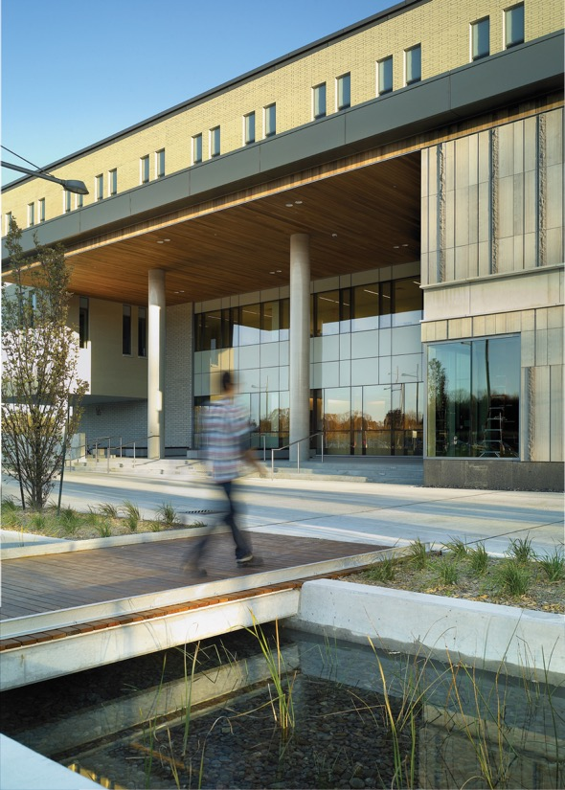
Expenses
Type | Undergraduate (CAD $)
Free exchange spot | Two semester students from Beuth per year will have tuition fees waived
Discounted tuition for Beuth exchange students | $7,000 per semester As free-mover
Ancillary Fees* (for all students) | $50 per 0.5 credit course
Health Insurance | $204 per semester
Textbooks | $500 - $1000 per semester (based on field of study)
*Ancillary fees cover: athletic facilities, LU Radio, Student Union, technology enhancement, Canadian Federation of Students membership, etc.

Slide 20
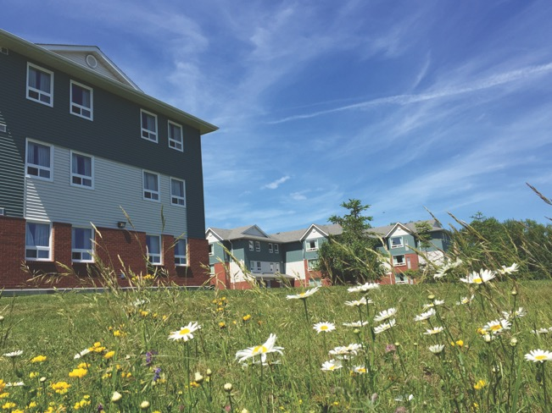

Housing
Expenses | On-campus | Off-campus
Housing (CAD $) | Monthly $911 - $1,477 (with or without food) | Monthly 2-bedroom apartment $900 - $1,200 *short-term rentals may be limited

Slide 21
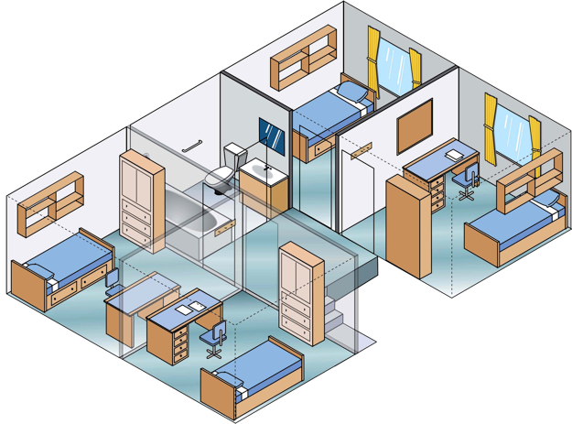
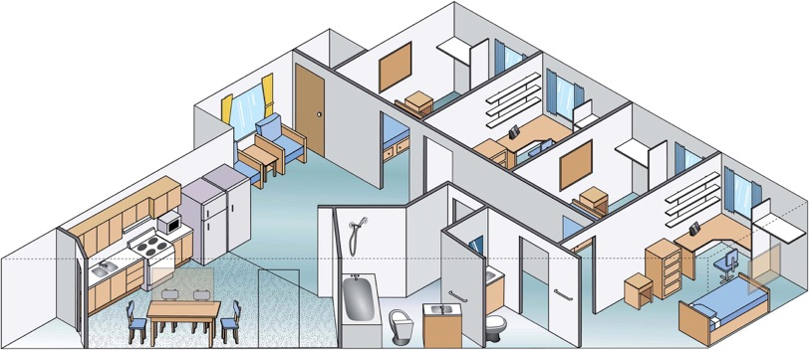

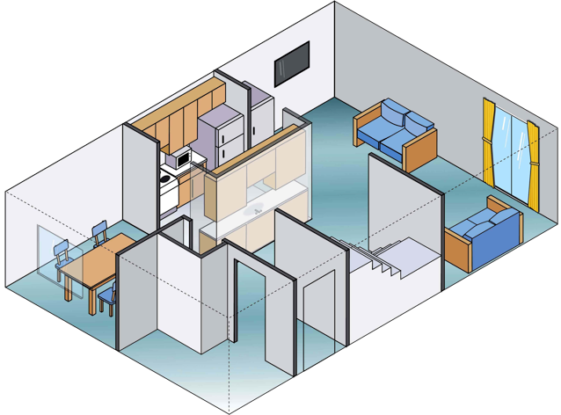
Residence Options
Townhouse 93m²
(Thunder Bay Campus)
Apartment (Thunder Bay Campus) 77m²

Slide 22
Requirements and Deadlines
Applications:
Incoming Exchange Student Application Form (form type based on whether nominated or fee-paying student) – Contact IEC to apply
Submit Official Transcripts: 60% Canadian equivalent required (Befriedigend oder Gut)
Language Requirements: Letter of English Proficiency Attestation from your University (recommended DAAD B2; ~ IELTS 6.5; ~ TOEFL 80)
Once Admitted, then apply for ETA (electronic travel authorization) and if studying for more than 6 months, apply for a Study Permit. Contact the Canadian Embassy in your country to secure appropriate paperwork.
Course Registration: choose 3 – 5 courses; we register for you
 | Fall 2018 Semester | Winter 2019 Semester
Orientation | End of August 2018 | Early January 2019
Classes | September 4 – December 3, 2018 | January 7 – April 6, 2019
Exams | December 6 – 21, 2018 | April 8 – 26, 2019
Application Deadline | April 30, 2018 (flexible) | October 31, 2018 (flexible)

Slide 23
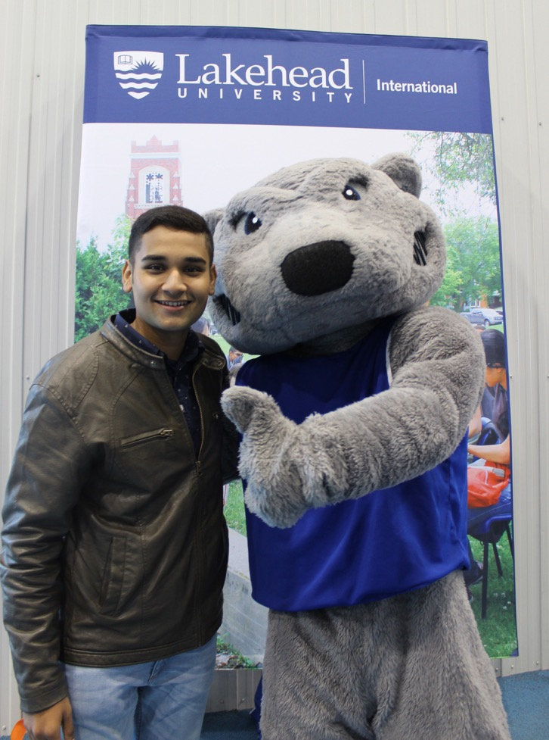
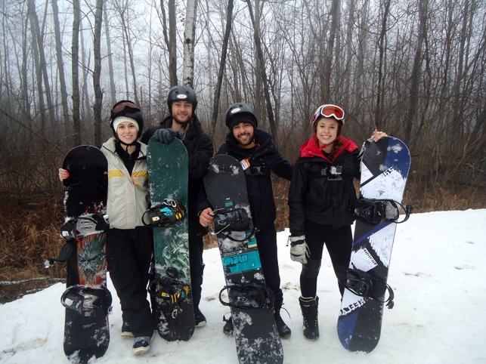
Welcoming You
Airport pickup
International Orientation
Social Activities and Events
Academic Advising
On-campus Health Centre
Visa and Permit Advising

Slide 24
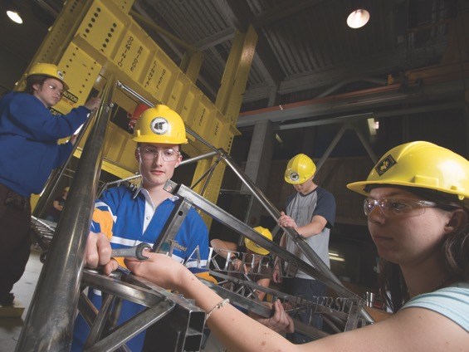
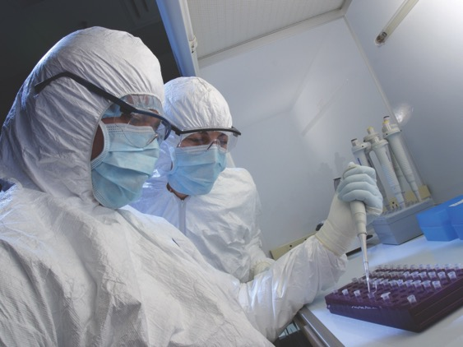
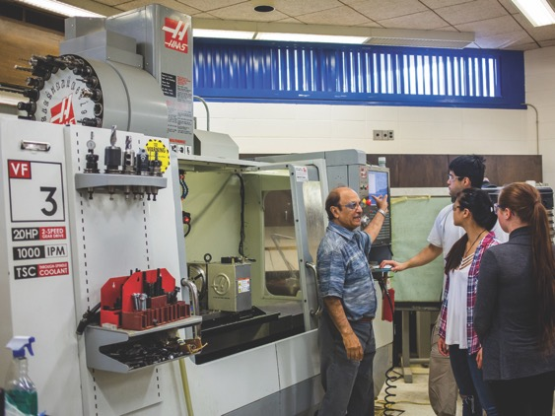
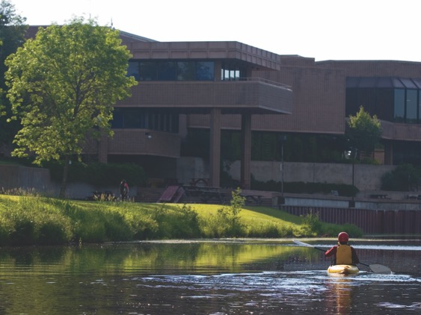
Facilities
Notes:
Bottom Left: CNC Lab for Mechanical Engineering: Computer Numerical Control. This is a 4 axis CNC vertical Milling Machine Centre that is used for teaching and manufacturing parts for undergraduate, graduate degree projects and research equipment for all Engineering departments.
Top Left: Structures Lab (Civil Engineering)
Top Right: Paleo-DNA Lab

Slide 25
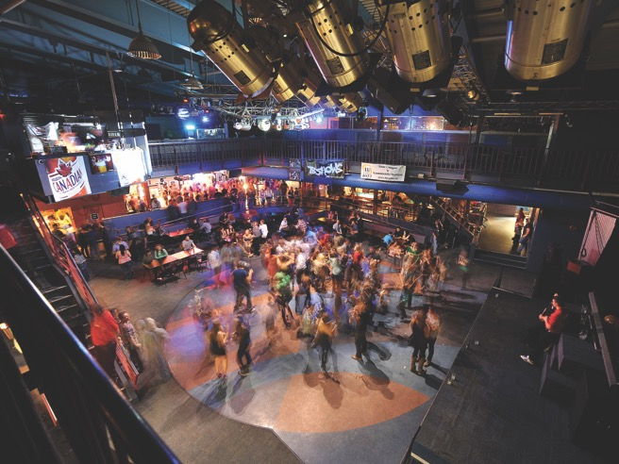

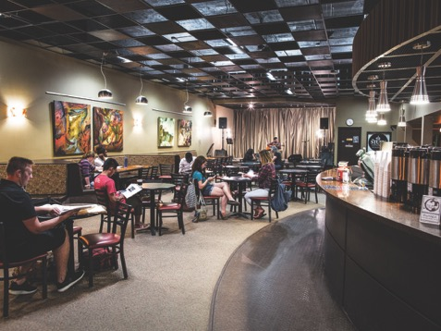
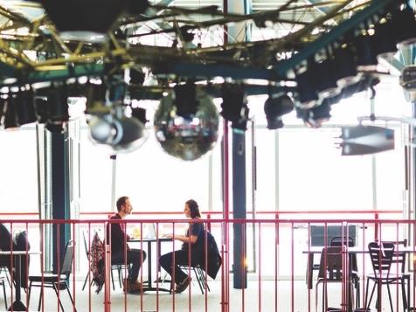
Facilities: Student Run Centres
The Study
The Outpost

Slide 26
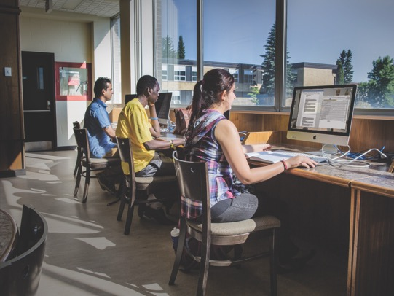
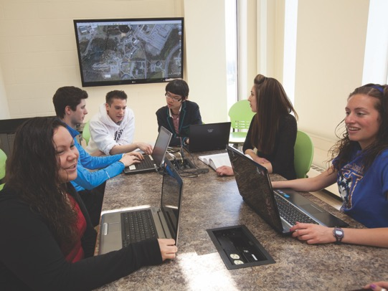
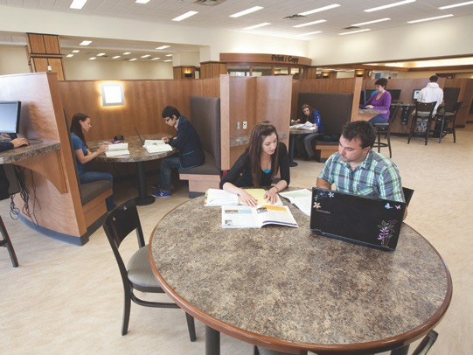
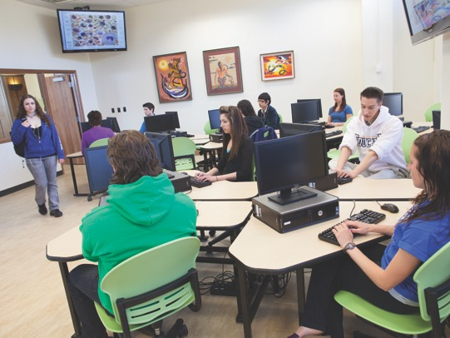
Facilities: Library
Notes:
Ample lab space
Group study rooms available to use
Learning Commons with group study areas & café
Designated quiet zones throughout the library

Slide 27

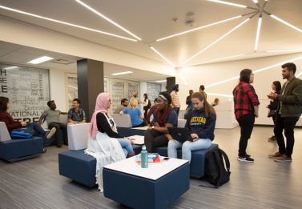
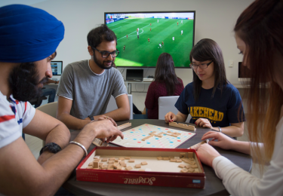
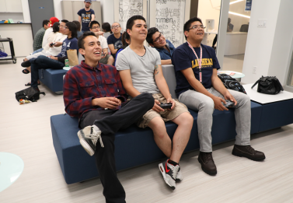
Facilities: International Centre

Slide 28
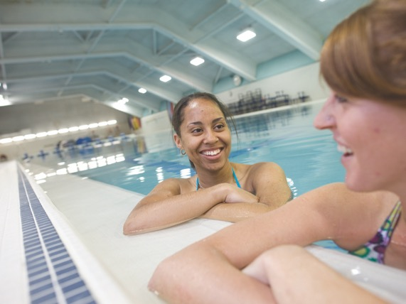
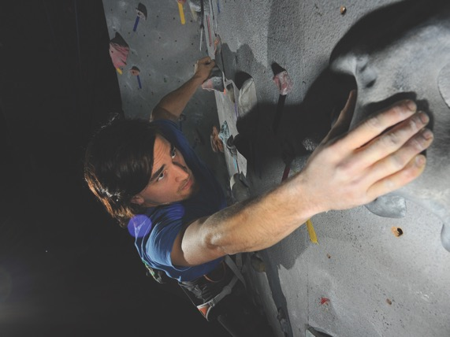

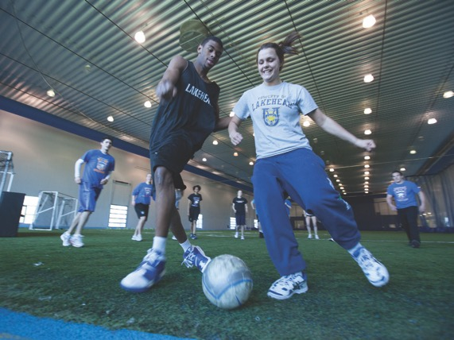
Facilities: Recreation
Notes:
50m – Olympic length pool
Indoor climbing wall
Hot yoga studio
Indoor soccer field with astroturf

Slide 29

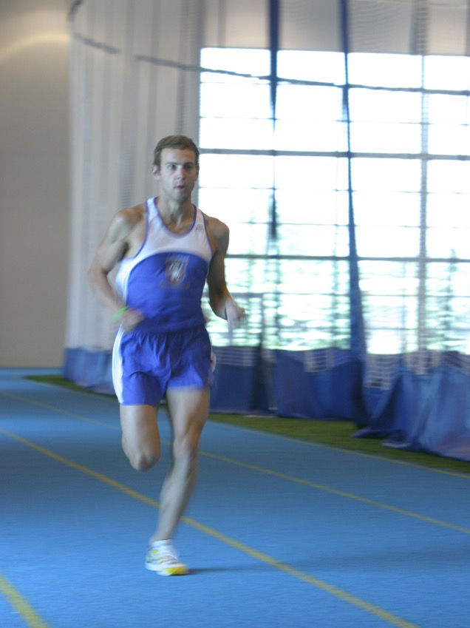
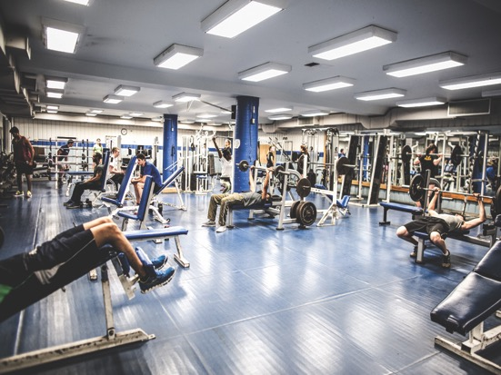
Facilities: Recreation
Notes:
Weight rooms (free weights, weight machines)
Cardio Rooms
200m indoor track

Slide 30

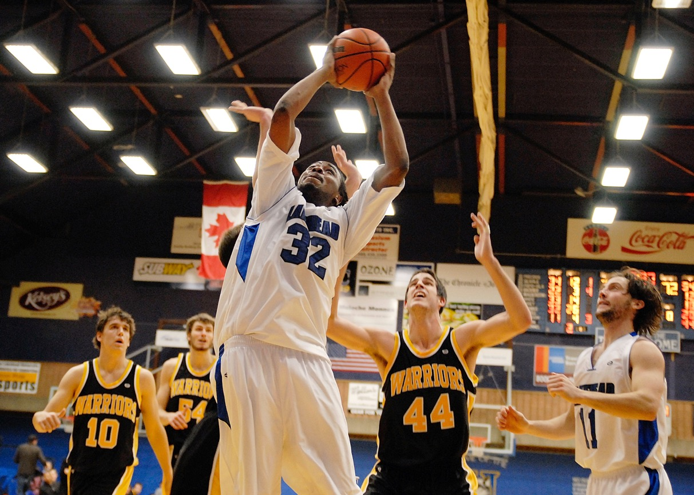
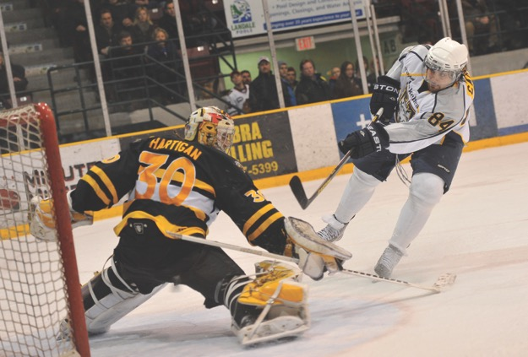
Campus Life: Athletics
Notes:
16 Varsity Teams
20+ Club Teams as well as Recreational Teams

Slide 31


Campus Life

Slide 32



Student Life

Slide 33




Thunder Bay: Population 110,000
Notes:
Thunder Bay has many hang-outs favoured by students. The music scene in Thunder Bay is vibrant as is arts and culture, with a professional symphony orchestra, live stage theatre, Canadian and American bands that pass through the city, several film festivals, two major art galleries, and more.

Slide 34




Thunder Bay Area
Notes:
305 days of sunshine per year
1.5 hour flight from Toronto (3 major airlines serve Thunder Bay)
Amazing vistas
Unparalleled access to outdoor recreational opportunities all year round.

Slide 35







Follow Lakehead
lakeheaduniversityinternational
lakeheadintl
lakeheaduniversity
lakeheadinternational
lakeheadu.ca/international

